Slide 1


Slide 2

30 Days Python Master Class
Day1 : Python
Time: 6.00 PM IST
Free Registration

Slide 3
Python Master Class
Handbook

Slide 4
NANDHINI.S
Exp: 5 Yrs
Expert in
Python Developer on Machine Learning
Deep learning with computer vision
Matlab – Image Processing
Autonomous Car design using ROS with LIDAR
Language – Python , Java , HTML ,CSS.
Tools – ANACONDA NAVIGATOR, JUPYTER NOTEBOOK,
GOOGLE COLAB.
Graduation : BE – ECE | 2011

Slide 5
Pantech?
Educational Equipment Manufacturer
IoT, AI, Robotics,Autonomous Robot
Microprocessor/Microcontroller
DSP,VLSI, Embedded System
Power Electronics & Drives, Fuel Cell Trainer Kit
Renewable Energy Lab, Electric Vehicle Lab
Technical Training
DIY Project

Slide 6

What is Master Class ?
👍 This is the 30 Days Industrial Learning Activity.
👍 Its Online YouTube Live Class
👍 If you Invest 45 minutes daily, U will become Master in Data Science
👍 You will get FREE E-Certificate
Webinar Participation Certificate
“Learning is the beginning of wealth.
Searching & Learning is where the miracle process all begins.” …………….Jim Rohn

Slide 7
Our Vision
Help 10 Million Students to Learn the Technology in Easy Way

Slide 8

Associate Partner for this Master Class
https://apssdc.in/home/

Slide 9
What U will Learn from 30 Days Data Science & Analytics Master Class

Slide 10
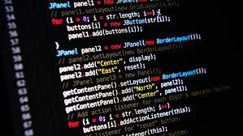
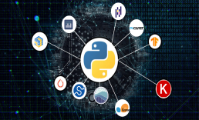

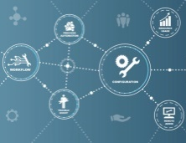
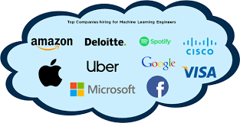
Python Learning Plan
01
02
03
04
05
Library
Python
Analytics
Analytics
Industry Project
Introduction To Python and Python Data Structures
Pandas
Numpy
MatplotLib
Cborn, SKLearn Lib
Collab
Distribution
Visualization
Aggregation
Statistics
Distribution Function
Project Building

Slide 11
Day wise Learning Plan
Day -1 : Introduction to Python
Day -2: Python – Tools|Syntaxes & Data Structures
Day -3: Python – Dictionaries,Date and Time
Day -4: Python – MySql
Day -5: Pandas library – Introduction
Day -6: Pandas library – Data Structures
Day -7: Numpy library – Introduction
Day -8: Numpy library – Array Manipulations, Mathematical Functions
Day -9: Matplotlib , Histogram Using Matplotlib | I/O With Numpy
Day -10: Matplotlib Library - Introduction , Pyplot API | Types Of Plots
Day -11: Seaborn Library
Day -12: SKLearn Library
Day -13: Python – Date and Time , Data Wrangling.
Day -14: Python – Data Cleansing
Day -15: Python – Word Tokenization , Stemming and Lammetization.

Slide 12
Day wise Learning Plan
Day -16: Python – Data Visualization
Day -17: Python – Statistical Analysis
Day -18: Python – Types Of Distribution
Day -19: Python – Correlation ,Chi-Square Test , Linear Regression
Day -20: Keras library – Introduction.
Day -21: Stock Price Prediction With Machine Learning LSTM RNN
Day -22: People’s behaviour in chat message using NLP NLP
Day -23: Gaming In Python
Day -24: Chatbot creation in Python NLP
Day -25: Electricity Price Prediction Using ML Random Forest Regressor
Day -26: Diamond Price Prediction Using Python Linear Regression
Day -27: Book Recommendation System KNN
Day -28: Image Classification Using CNN CNN
Day -29: Titanic Survival Analysis Using ML Logistic Regression
Day -30: Blockchain in Python

Slide 13
List of Projects for Demo in YouTube Live
Stock Price Prediction With Machine Learning
People’s behaviour in chat message using NLP
Gaming In Python
Chatbot creation in Python
Electricity Price Prediction Using ML
Diamond Price Prediction Using Python
Book Recommendation System
Image Classification Using CNN
Titanic Survival Analysis Using ML
Blockchain in Python
All Projects in Jupyter Notebook

Slide 14
What you will get from this Free 30 Days Master Class?
You can attend YouTube Live Class
Free E-Certificate ( WEBINAR PARTICIPATION CERTIFICATE)

Slide 15
How to mark your Attendance in YouTube Live Class?
Ans : During the Live Class, organizer will post Google Form link in Live Chat. The Participants should submit the from on daily basis. Minimum 25 Days Attendance is Required to get Free Master Class Participation Certificate.
Note : The Link will be available during the Live. From the LIVE Class date, the live video will get removed from the YouTube in 3 days.

Slide 16
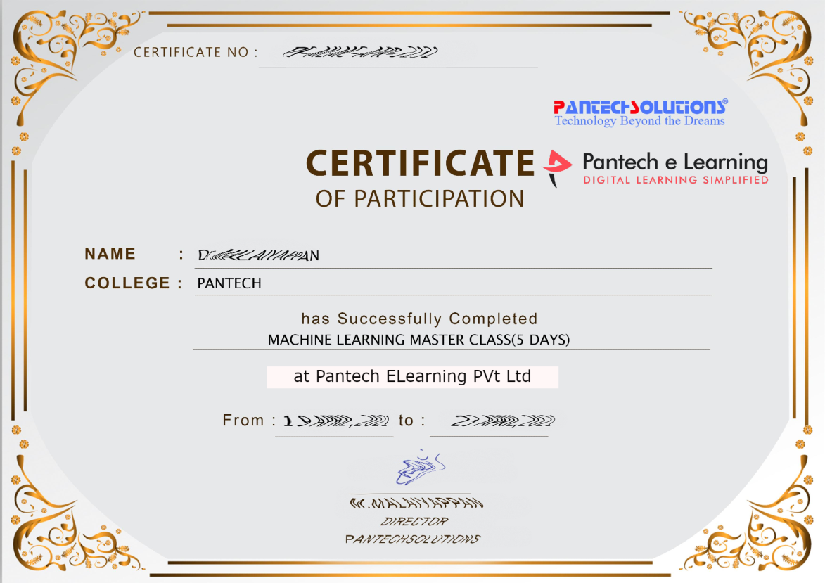

Sample Webinar Participation Certificate?

Slide 17
https://www.pantechelearning.com/data-science-master-class/
On Demand
You can get chance to apply 1 Month Internship on Data Science & Analytics Master Class

Slide 18
What is Internship????
Learn
Practice
Verify
Get Certified
Grow

Slide 19
Free Master Class DSA | 1 Month Internship on DSA
Master Class Participation Certificate | Internship Completion Certificate
Minimum 25 Class should attend YouTube Live | Recorded Class Link will be provided. – LMS Portal Access
YouTube Live Mandatory | Your Choice. You can attend Live or else You can watch Recorded Class in LMS Portal
All Projects Demo class in YouTube Live | Step by Step Video Explanation Content in LMS Portal
Access : 3 Days | VIP WhatsApp Group Support
 | You Can Download All PPTs
 | 4 Nos of Hackathon Class in Zoom Live. The Recording also will be provided
 | You Can Download All Project Files
 | Mentor will guide you to finish 10 Projects
 | Access : 60 Days

Slide 20
Pantech will make you to Create 10 Projects in Data Science & Analytics in 30 Days
Objective of this 30 Days Master Class

Slide 21
1 Month Internship in Data Science
INTERNSHIP E-Certificate(30Days Internship on Data Science Engineering)
Highly organized Video content
Download All Files
Download PPTs
Assignments
Flexible Time.
Access Period: 60Days from the date of payment

Slide 22
What You Will Get???
Complete Project Files
30 Days Learning Activity
Data Science Core Concepts
10 + Projects
Project PPT
Spatial Data Science For Covid-19 Disease Prediction
Parkinson’s Disease Prediction-XGBoost Classifier
House Price Prediction-Random Forest Regression
Customer Segmentation Using ML-K-Means Clustering
Home Loan Prediction-Decision Tree Classifier
Spam Classification-NLP
Hand Written Digit Recognition Using Python-CNN
Churn Prediction-Deep Learning
Crop Yield Prediction
Ground water level prediction
Video Class Access for 2 Months
Get chance to Enroll 1-Month Internship on demand

Slide 23
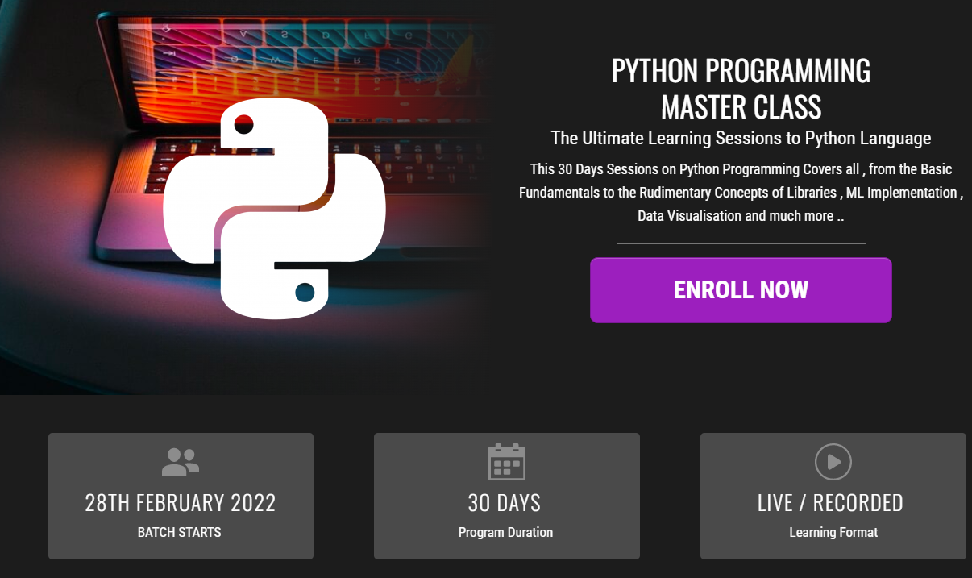
How to join in 1 month Internship
https://www.pantechelearning.com/pymc-internship/
Coupon Code: PYMC

Slide 24
Python - matplotlib

Slide 25
Matplotlib
It is one of the popular packages used for data visualisation.
It is a cross-platform library for making 2D plots from data in arrays.
It is written in python and makes use of numpy of python.
It provides an object-oriented API.

Slide 26
Matplotlib:
It has a procedural interface called pylab and it was developed by mathworks.
Matplotlib along with Numpy can be considered as a open source equivalent of Matlab.
It was written by John.D.Hunter in 2003.

Slide 27
MATPLOTLIB:
Matplotlib packages are available in the form of packages on the std python package repositories .
It can installed on windows and linux using pip package installer.
Matplotlib can be installed using the following command.
Pip3 install matplotlib.

Slide 28
Matplotlib - dependencies
It requires a lot of dependencies.
Python
Numpy
Setuptools
Dateutil
Pyparsing
Libpng
Pytz
freetype

Slide 29
Matplotlib
To support animation support format,we can use the following:
_mpeg/avconv
ImageMagick
Pillow(>=2.0)
Latex and Ghostscript

Slide 30
Matplotlib – anaconda distribution
Anaconda is a free and open source distribution of python for predictive analytics and scientific computing.
Matplotlib and other data science tools form part of the distribution.
Package versions are available by the package management system conda.

Slide 31
Matplotlib – jupyter notebook
Jupyter notebook supports python and many other languages.
Ipython is a command shell for interactive computing in many programming languages and it was developed for python.

Slide 32
Features provided by ipython:
Interactive shells.
A browser-based notebook with support for code,text and mathematical expression.
Support for interactive data visualisation.

Slide 33
Open jupyter notebook:
First, open anaconda navigator.
Navigator displays the installed components in the distribution.
Launch Jupyter notebook from the navigator.
Click ,python3 notebook and a new notebook will get opened.

Slide 34
MATPLOTLIB - PYPLOTAPI
A new untitled notebook with .ipynb extension is displayed.
Matplotlib.pyplot is a collection of command style functions that make matplotlib work like matlab.
Pyplot functions are used for making some changes in the figure.
A function creates a figure,plots lines in the plotting area and decorates the plots with labels.

Slide 35
Types of plots:
Bar – Makes a bar plot.
Barh – Used for making a horizontal bar plot.
BoxPlot – Used for making a box and whisker plot.
Hist – Plots a histogram
hist2D – Used for plotting 2D Histogram.
Pie – Used for plotting a pie chart.
Plot – Plots lines to the axes.
Polar – Makes a polar plot.

Slide 36
Image functions:
Imread – Reads an image from the file into an array.
ImSave – Save an array as an image file.
Imshow – Used for displaying an image on the axes.

Slide 37
Task:
Write a program to illustrate the various image functions in python.

Slide 38
Axis functions:
Axes – Add axis to the figure.
Text – Used for adding text to the axes.
Title – Used for setting a title to the current axes.
Xlabel – Set the x-axis labels for the current axis.
Xlim – Set the xlimits of the current axis.
Ylim – Set the ylimits of the current axis.
Yscale – Set the scaling of y-axis.

Slide 39
FIGURE FUNCTIONS:
FigText – Add text to the figure.
Figure – creates a new figure.
SaveFig – Save the current figure.
Close – Close a figure window.

Slide 40
MATPLOTLIB – SIMPLE PLOT:
Now, we will see how to display a simple line plot of angle in radians vs its sine value in matplotlib.
Write a simple import statement
import matplotlib.pyplot as plt
We need an array of numbers to plot.
Various array functions are available in the numpy library and it is imported with np alias.
Import numpy as np

Slide 41
Matplotlib – simple plot:
Obtain the ndarray object of angles between 0 and 2pi using arange() function from the numpy library.
x = np.arange(0, math.pi*2, 0.05)
The ndarray object serves as values on xaxis of graph.
The corresponding sine values of angles in x to be displayed on the y axis are obtained by the following statement.

Slide 42
MATPLOTLIB – SIMPLE PLOT:
Y = np.sin(x)
The values from the two array are plotted using the plot function.
Plt.plot(x,y)
We can see the plot titles and labels for x and y axis.
The ndarray object serves as values on x-axis of graph.
The corresponding sine values of angles in x to be displayed on the y axis are

Slide 43
Matplotlib-simple plot:
Obtained by:
Y = np.sin(x)
The values from two arrays are plotted using the plot function:
Plt.plot(x,y)
We can set the plot title and labels for x and y axes.
You can set the plot title, and labels for x and y axes.
plt.xlabel("angle")
plt.ylabel("sine")
plt.title('sine wave')

Slide 44
MATPLOTLIB – SAMPLEPLOT:
from matplotlib import pyplot as plt
import numpy as np
import math #needed for definition of pi
x = np.arange(0, math.pi*2, 0.05)
y = np.sin(x)
plt.plot(x,y)
plt.xlabel("angle")
plt.ylabel("sine")
plt.title('sine wave')
plt.show()

Slide 45
Task:
Find the error in the following code,fill in the missing code,find the tan of the given angle and then show the result in the form of a graph.
Import numpy as np
_______
X = np.arange(___________)
Y = np.__________
________.pyplot(_________)

Slide 46
MATPLOTLIB – SAMPLEPLOT:
Launch Jupyter notebook from Anaconda Navigator.
from matplotlib import pyplot as plt
import numpy as np
To display plot outputs inside the notebook,enter the following statement.
%matplotlib inline

Slide 47
MATPLOTLIB – SIMPLE PLOT
X is an ndarray object containing angles in radians between 0 to 2pi and y is the sine value of each angle.
import math
x = np.arange(0, math.pi*2, 0.05)
y = np.sin(x)

Slide 48
Matplotlib - simpleplot
Set labels for x and y axes as well as the plot title.
plt.xlabel("angle")
plt.ylabel("sine")
plt.title('sine wave')
Execute the plot function to generate the sine wave display in notebook.
plt.plot(x,y)

Slide 49
MATPLOTLIB – PYLAB MODULE:
Pylab is a procedural interface to the Matplotlib-object oriented plotting library.
Matplotlib is the whole package and matplotlib.pyplot is a module in matplotlib.
Pylab is a module and it gets installed alongside matplotlib.

Slide 50
Basic plotting:
Plotting curves is done with the help of plot command.
It takes a pair of same length arrays and sequences.
from numpy import *
from pylab import *
x = linspace(-3, 3, 30)
y = x**2 plot(x, y)
show()

Slide 51
TASK:
Write a program to illustrate the use of pylab and plot function in matplotlib.

Slide 52
BASIC PLOTTING:
To plot symbols other than lines,provide an additional string argument.
Symbols - - , –, -., , . , , , o , ^ , v , < , > , s , + , x , D , d , 1 , 2 , 3 , 4 , h , H , p , | , _
Colors - b, g, r, c, m, y, k, w

Slide 53
Execute the code:
from pylab import *
x = linspace(-3, 3, 30)
y = x**2 plot(x, y, 'r.')
show()

Slide 54
MATPLOTLIB:
Plots can be overlaid.
Use multiple plot commands.
Use clf() to clear the plot.
from pylab import *
X = linspace(-3,3,30)
plot(x, sin(x))
plot(x, cos(x), 'r-')
plot(x, -sin(x), 'g--')
show()

Slide 55
TASK:
Fill in the missing code, find the error in the following code and then write the correct code.
Import numpy as np
__________________
X = np.linspace(__________)
Plot(x,_____)
Plot(x,tan(x),)
Plot(x,__________)

Slide 56
Object oriented interface:
It is easier to generate plots with matplotlib.pyplot module.
Object-oriented approach Is recommended as it gives more control over our plot.
All the functions are available in matplotlib.axes.Axes class.
The idea behind this is that create figure objects and then call methods of that object.

Slide 57
Object – oriented interface
Pyplot is used only for a few functions such as figure creation and then call methods of that object.
It helps in dealing with canvas.
User use pyplots to create figures
fig = plt.figure()

Slide 58
Now add axes to figure. The add_axes() method requires a list object of 4 elements corresponding to left, bottom, width and height of the figure. Each number must be between 0 and 1 −
ax=fig.add_axes([0,0,1,1])

Slide 59
Set labels for x and y axis as well as title −
ax.set_title("sine wave") ax.set_xlabel('angle')
ax.set_ylabel('sine')

Slide 60
Invoke the plot() method of the axes object.
ax.plot(x,y)

Slide 61
If you are using Jupyter notebook, the %matplotlib inline directive has to be issued; the otherwistshow() function of pyplot module displays the plot.

Slide 62
from matplotlib import pyplot as plt
import numpy as np
import math
x = np.arange(0, math.pi*2, 0.05)
y = np.sin(x) fig = plt.figure()
ax = fig.add_axes([0,0,1,1])
ax.plot(x,y)
ax.set_title("sine wave")
ax.set_xlabel('angle')
ax.set_ylabel('sine')
plt.show()

Slide 63
Matplotlib –figure class;
Matplotlib.figure module contains the figure class.
It is the top-level container for all plot elements.
Figure object is initiated by calling the figure() function from the pyplot module.

Slide 64
Additional parameters:
The following are the additional parameters.
FigSize – (width,height) – tuple in inches.
Dpi – dots per inches.
Facecolor – Figure patch face color.
Edgecolor – Figure patch edge color.
Linewidth – Edge line width.

Slide 65
Matplotlib – axes class:
Axes object – It is the region of the image with the data space.
A figure may contain many axes but a axes object contains only one figure.
The axes contains two or three axes objects.
Axes class and member functions are the main points to work with OO interface.
Axes object is added to the figure by calling the add_axes() method.
It returns the axes object and adds an axes at position rect(left,bottom,width and height)

Slide 66
PARAMETER:
Following is the parameter for axes class-
Rect-A4-length sequence of[left,bottom,width,height] quantities.
ax=fig.add_axes([0,0,1,1])
The following member functions of axes class add different elements to the plot-

Slide 67
Matplotlib – axes class:
Legend – legend() method of axes class adds a legend to the figure.
It takes three parameters.
ax.legend(handles, labels, loc)
Labels is a group of strings.
It handles a line2D or patch instances.
Loc can be an integer or string which specifes the legend location.

Slide 68
Legend:
Location string Location code
best 0
upper right 1
upper left 2
lower left 3
lower right 4
Right 5
Center left 6
Center right 7
lower center 8
upper center 9
Center 10

Slide 69
Axes.plot()
It is the basic method of axes class.
It plots values of one array versus another as arrays or markers.
Plot() method has an optional format string argument which specifies the color,style and size of line and marker.

Slide 70
Color codes:
Character Color
‘b’ blue
‘g’ green
‘r’ red
‘b’ blue
‘c’ cyan
‘m’ majentha
‘y’ yellow
‘k’ black
‘b’ blue
‘w’ white

Slide 71
Marker codes:
Character Description
‘.’ point marker
‘o’ Circle marker ‘x’ X marker
‘D’ diamond marker
‘H’ Hexagon marker
‘s’ square marker
‘+’ plus marker

Slide 72
Line styles:
Character Description
‘-‘ Solid line
‘—‘ Dashed line
‘-.’ Dash-dot line ‘:’ Dotted line ‘H’ Hexagon marker

Slide 73
Example:
The example shows the advertisement expenses annd sales figures of TV and smart phones .
It is shown in the form of line plots.
Solid line denotes TV line with yellow color and square markers.
Dashed line denotes smart phone line with green color and circle marker

Slide 74
import matplotlib.pyplot as plt
y = [1, 4, 9, 16, 25,36,49, 64]
x1 = [1, 16, 30, 42,55, 68, 77,88]
x2 = [1,6,12,18,28, 40, 52, 65]
fig = plt.figure()
ax = fig.add_axes([0,0,1,1])
l1 = ax.plot(x1,y,'ys-') # solid line with yellow colour and square marker
l2 = ax.plot(x2,y,'go--') # dash line with green colour and circle marker
ax.legend(labels = ('tv', 'Smartphone'), loc = 'lower right') # legend placed at lower right ax.set_title("Advertisement effect on sales") ax.set_xlabel('medium')
ax.set_ylabel('sales')
plt.show()

Slide 75
Task:
Write a program to illustrate how ages of people have got an impact on smartphones and use plot function and matplotlib for data visualisation.

Slide 76
Matplotlib - multiplot
We can create multiplot lib on same canvas.
Subplot() function returns the axes object at the given grid position.
Call signature of this function is-
plt.subplot(subplot(nrows, ncols, index)
Inthis,function creates and returns an axes object at position index of grid of nrows and ncolsaxes.

Slide 77
Matplotlib - multiplots
Indexes go from 1 to nrows * ncols incrementing in row major order.
Ncols and index are less than 10
Indexes can be given as single,concatenated and three digit number.
Subplot(2,3,3) and subplot(233) create an axes on the top right corner of the figure .
It occupies half of the figure height and a third of the figure width.

Slide 78
Example:

Slide 79
import matplotlib.pyplot as plt
# plot a line, implicitly creating a subplot(111) plt.plot([1,2,3])
# now create a subplot which represents the top plot of a grid with 2 rows and 1 column.
#Since this subplot will overlap the first, the plot (and its axes) previously created, will be removed plt.subplot(211)
plt.plot(range(12))
plt.subplot(212, facecolor='y') # creates 2nd subplot with yellow background
plt.plot(range(12))

Slide 80
TASK:
Find the error in the following code, fill in the missing code and write the correct code.
Import _________
Import numpy as np
Np = np.range(______)
Hj = np.subplot(_________)
Np = ______

Slide 81
MATPLOTLIB - SUBPLOTS:
The add_subplot function of the figure class will not overwrite the existing plot.
import matplotlib.pyplot as plt
fig = plt.figure()
ax1 = fig.add_subplot(111)
ax1.plot([1,2,3])
ax2 = fig.add_subplot(221, facecolor='y') ax2.plot([1,2,3])

Slide 82
TASK:
Write a program to illustrate the use of use of add_subplot() function of figure class.

Slide 83
Matplotlib – subplots:
We can insert plot in the same figure by adding another axes object in the same canvas.

Slide 84
import matplotlib.pyplot as plt
import numpy as np
import math
x = np.arange(0, math.pi*2, 0.05)
fig=plt.figure()
axes1 = fig.add_axes([0.1, 0.1, 0.8, 0.8])
# main axes axes2 = fig.add_axes([0.55, 0.55, 0.3, 0.3])
# inset axes y = np.sin(x)
axes1.plot(x, y, 'b')
axes2.plot(x,np.cos(x),'r')
axes1.set_title('sine')
axes2.set_title("cosine")
plt.show()

Slide 85
TASK:
Find the error in the following code,fill the missing code and write the correct code.
Import matplotlib.pyplot as plt
Import num _____
Import pandas as _______
X = np.arange(________)
Fg = np._________
Y = np.______
_____
_____
_______

Slide 86
Matplotlib –subplots() function
The pyplot API of Matplotlib() has a convenient function called subplots().
It acts like a utility wrapper and helps in creating common layouts of subplots.
It includes enclosing figure object in a single call.

Slide 87
MATPLOTLIB – SUBPLOTS() FUNCTION:
Plt.subplots(nrows,ncols)
The two arguments to this function specifies the number of rows and number of columns attributes of the subplot grid.
The function returns a figure object and a tuple containing axes objects equal to nrows and ncols.
Each axes object can be accessed by using the index.

Slide 88
Matplotlib – subplots() function:
We create a subplot of two rows and two columns and display 4 different subplots in each plot.

Slide 89
import matplotlib.pyplot as plt
fig,a = plt.subplots(2,2)
import numpy as np
x = np.arange(1,5)
a[0][0].plot(x,x*x)
a[0][0].set_title('square')
a[0][1].plot(x,np.sqrt(x))
a[0][1].set_title('square root')
a[1][0].plot(x,np.exp(x))
a[1][0].set_title('exp')
a[1][1].plot(x,np.log10(x))
a[1][1].set_title('log')
plt.show()

Slide 90
TASK:
Find the error in the following code,fill the missing code and write the correct code.
Import matplotlib.plt as ____
Fg,a = plt.subplot(________)
Import numpy as np
X = np.arange(_____)
A[0][0] = np._________
A[0][0] = np.set_title(_______)
Fill the remaining code to get the correct output.

Slide 91
Matplotlib – subplot2grid() function:
It gives more flexibility in creating an axes object at a specific location of the grid.
Axes object can be spanned across multiple rows and columns.
Plt.subplot2grid(shape, location, rowspan, colspan)
In the following example, a 3X3 grid of the figure object is filled with axes objects of varying sizes in row and column spans, each showing a different plot.

Slide 92
import matplotlib.pyplot as plt
a1 = plt.subplot2grid((3,3),(0,0),colspan = 2)
a2 = plt.subplot2grid((3,3),(0,2), rowspan = 3)
a3 = plt.subplot2grid((3,3),(1,0),rowspan = 2, colspan = 2)
import numpy as np
x = np.arange(1,10) a2.plot(x, x*x) a2.set_title('square')
a1.plot(x, np.exp(x))
a1.set_title('exp')
a3.plot(x, np.log(x))
a3.set_title('log')
plt.tight_layout()
plt.show()

Slide 93
TASK:
Write a program to illustrate the use of subplot2Grid() of matplotlib.

Slide 94
Matplotlib - grids
The grid function of axes object sets the visibility of grid inside the figure to be on or off.
We can display the major or minor ticks of the grid.
We can also set the color, linestyle and linewidth properties of the grid() function.

Slide 95
TASk:
Find the error in the following code, fill in the missing code and write the correct code.
Import matplotlib.plt as ____
Import numpy as np
Fg,axes = _____________.
Fill in the remaining code to get the correct output.

Slide 96
import matplotlib.pyplot as plt
import numpy as np
fig, axes = plt.subplots(1,3, figsize = (12,4))
x = np.arange(1,11)
axes[0].plot(x, x**3, 'g',lw=2)
axes[0].grid(True)
axes[0].set_title('default grid')
axes[1].plot(x, np.exp(x), 'r')
axes[1].grid(color='b', ls = '-.', lw = 0.25)
axes[1].set_title('custom grid')
axes[2].plot(x,x)
axes[2].set_title('no grid')
fig.tight_layout()
plt.show()

Slide 97
Matplotlib – formatting axes
One or two points are much better than the bulk data.
The scale of the axes is set to be logarithmic rather than normal scale.
In matplotlib , the xscale or vscale properties of object can be set to log.
There can be additional distance between axis numbers and axis label.
The labelpad properties of x and y axis can be set to the desired value.

Slide 98
MATPLOTLIB – EXAMPLE:
The two features are shown with the help of example.
The subplot on the right has a logarithmic scale and one on the left has it’s x axis having labels at more distance.

Slide 99
import matplotlib.pyplot as plt
import numpy as np
fig, axes = plt.subplots(1, 2, figsize=(10,4))
x = np.arange(1,5)
axes[0].plot( x, np.exp(x))
axes[0].plot(x,x**2)
axes[0].set_title("Normal scale")
axes[1].plot (x, np.exp(x))
axes[1].plot(x, x**2)
axes[1].set_yscale("log")
axes[1].set_title("Logarithmic scale (y)")
axes[0].set_xlabel("x axis")
axes[0].set_ylabel("y axis")
axes[0].xaxis.labelpad = 10
axes[1].set_xlabel("x axis")
axes[1].set_ylabel("y axis")
plt.show()

Slide 100
Matplotlib – formatting axes
Axis spines are nothing but lines connecting axis tick marks which demarcates boundaries of plot area.
Axes object has spines located at top , bottom, left and right.
Each spine can be formatted by specifying the colour and width.
Any edge can be made invisible if its color is set to none.

Slide 101
import matplotlib.pyplot as plt
fig = plt.figure()
ax = fig.add_axes([0,0,1,1])
ax.spines['bottom'].set_color('blue')
ax.spines['left'].set_color('red')
ax.spines['left'].set_linewidth(2)
ax.spines['right'].set_color(None)
ax.spines['top'].set_color(None)
ax.plot([1,2,3,4,5])
plt.show()

Slide 102
TASK:
Write a program to illustrate the use of axes spines using matplotlib.

Slide 103


